Slide 1
Partnerships for a Healthier Charles County Community Health Training Session
February 16, 2022
Amber Starn, Chair, Partnerships for a Healthier Charles County

Slide 2
What does Population Health mean?
Population health is “the health outcome of a group of individuals, including the distribution of such outcomes within the group,” Kindig and Stoddart said in the American Journal of Public Health.
“We argue that the field of population health includes health outcomes, patterns of health determinants, and policies and interventions that link these two.”

Slide 3
Then, What does Public Health mean?
Public health are the approaches we use to improve the health of a population.
Anyone can do this, whether it’s a government public health department, a provider, or other organizations based in the community.
This term is often used to describe the local, state, and federal government public health agencies.

Slide 4
Lastly, What is Community Health?
Community Health is about how you do it.
It’s about multi-sector collaboration and approaching it in a culturally sensitive way.
It’s about engaging with the community using scientific and evidence-based approaches that meet the needs and interests of the community.

Slide 5
What is the difference between community/population/public health?
The term you use seems to be based on the industry.
Population health is a term more commonly used in the clinical sphere and the health IT industry, while the phrase public health tends to be favored by government officials and the stakeholders who work closely with them.
Ideally, population health management and public health initiatives should all include collaboration across the care continuum and into the community.

Slide 6
History of the Coalition
The Partnerships for a Healthier Charles County (PHCC) was established in 1994 to serve as a community health network and as a forum for collaboration and sharing of information between county agencies and services.
Over thirty non-profit and county agencies are represented in the membership and include a diverse group of agencies from government, health care, non-profit, social services, community services, insurance companies, health clinics, public schools, college, public health, and faith-based.

Slide 7
LHIC Structure
Membership is free and open to all
Executive leadership of the PHCC is shared by the heads of four local entities: the Charles County Department of Health, the Charles County Public Schools, the University of Maryland Charles Regional Medical Center, and the College of Southern Maryland.
A steering committee is comprised of representatives from each of the four entities and serves as an advisory board to the executive leadership.
The steering committee meets quarterly to set the priorities and direction of the coalition and to develop the agendas and speakers for each general meeting.

Slide 8
Mission and Vision
The focus of the PHCC is to improve the health outcomes of county residents as laid out the Charles County Health Needs Assessment, the Maryland State Health Improvement Process, and the federal Healthy People 2030 goals.
The MISSION of the Partnerships for a Healthier Charles County is to serve as a community health network and forum for collaboration to identify and address the health needs of our community.
The VISION of the Partnerships for a Healthier County is to improve the health and quality of life for all Charles County citizens with the goal of increasing life expectancy across all racial and ethnic groups.

Slide 9
Community Health Priorities
The health needs prioritized include:
1. Disease Prevention and Management: This includes major cardiovascular disease, obesity, diabetes, and infectious disease
2. Behavioral Health: Including mental health and substance use
3. Access to Care: Emphasis on health literacy, social determinants of health, and physician recruitment/retainment.
Notes:
This likely translates to your workgroups. Address diabetes work and strategy here.

Slide 10
CHNA & CHIP Processes
The Charles County Community Health Needs Assessment Report is conducted every 3 years. The latest report was completed in 2021.
After cumulative analysis of both quantitative and qualitative data collection, the steering committee used the Hanlon method to objectively prioritize health needs in the county taking into account the size of the problem, the seriousness of the problem, and the effectiveness of interventions.
There are 3 active subcommittees based on the identified health priorities: Access to Care, Behavioral Health, and Disease Prevention and Management Team.
The teams meet monthly or quarterly to work on collaborative projects and to provide updates on work being done in the county.

Slide 11
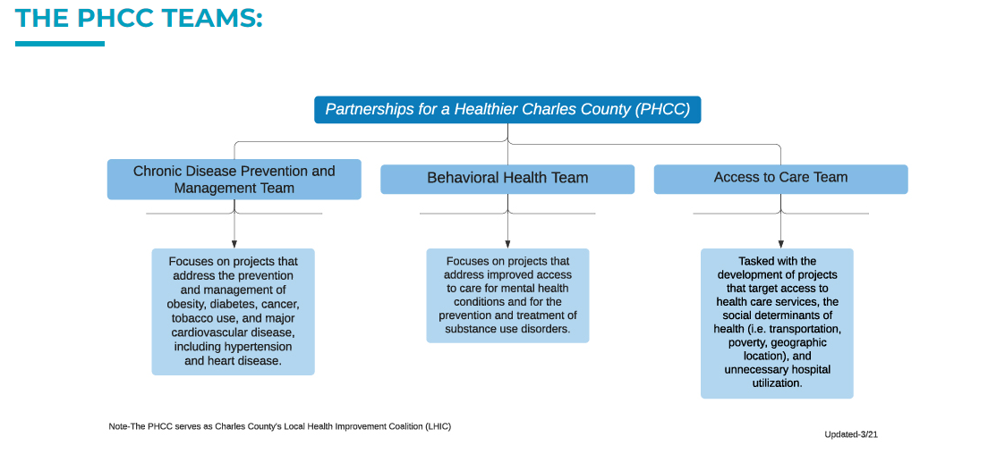

Slide 12
The Role Of Data
Each team has developed a 3-year action plan for FY22-24 with short term, intermediate, and long-term objectives as well as defined strategies and activities for obtaining those goals.
All objectives are SMART objectives, meaning that they are:
Specific
Measurable
Achievable
Realistic
Time Based
Example from our Access to Care Action Plan:
“Reduce the Charles County preventable hospital stay rate from 5108 per 100,000 Medicare enrollees to 4852.6 (5% reduction) per 100,000 Medicare enrollees by June 30, 2024.” Source: County Health Rankings
Notes:
Describe:
how the LHIC uses data for decision making
how members participate in the data gathering/analysis/interpretation process

Slide 13
Statewide Integrated Health Improvement Strategy (SIHIS)
In December 2019, Maryland & Centers for Medicare and Medicaid Services (CMS) signed a Memorandum of Understanding (MOU) agreeing to establish a Statewide Integrated Health Improvement Strategy.
This initiative is designed to engage State agencies and private-sector partners to collaborate and invest in improving health, addressing disparities, and reducing costs for Marylanders.
The State submitted its proposal outlining goals, measures, milestones, and targets to Center for Medicare and Medicaid Innovation (CMMI) on December 14, 2020. The full proposal can be read on the HSCRC website.
1. Hospital Quality
3. Total Population Health
2. Care Transformation Across the System

Slide 14
Guiding Principles for Maryland’s Statewide Integrated Health Improvement Strategy (SIHIS)
Maryland’s strategy should fully maximize the population health improvement opportunities made possible by the TCOC Model
Goals, measures, and targets should be specific to Maryland and established through a collaborative public process
Goals, measures and targets should reflect an all-payer perspective
Goals, measures and targets should capture statewide improvements, including improved health equity
Goals for the three domains of the integrated strategy should be synergistic and mutually reinforcing
Measures should be focused on outcomes whenever possible; milestones, including process measures, may be used to signal progress toward the targets
Maryland’s strategy must promote public and private partnerships with shared resources and infrastructure

Slide 15
For Further Information:
If you know any individuals or organizations who would like to join the PHCC, please have them email or call Kim Johnson at:
301-609-6901
kjohnson@maryland.gov
They can also go to our website at www.charlescountyhealth.org/LHIC
There is an interest form at the bottom of the page. We will add them to our email list and follow up with them.

Slide 16
2022 Meeting Dates:
May 18th
September 21st
December 14th

Slide 17
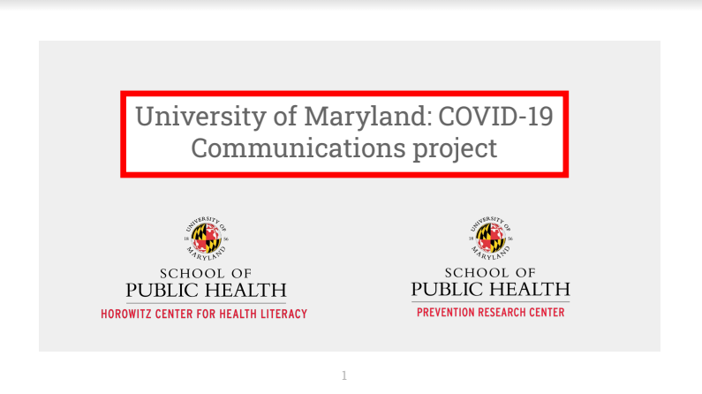

Slide 18
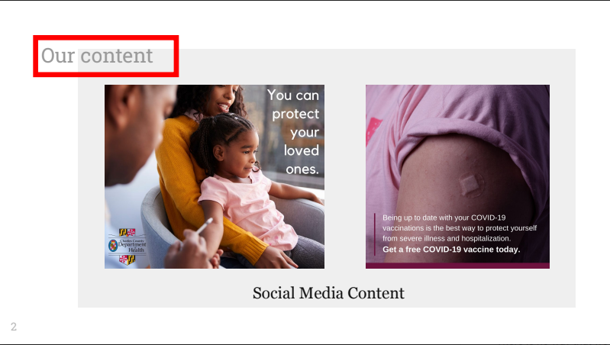

Slide 19
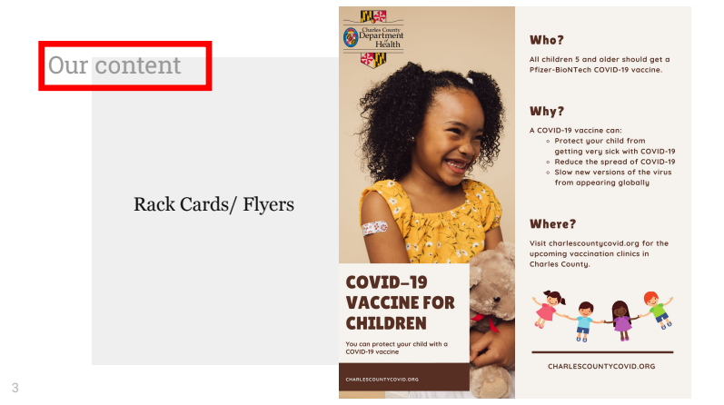

Slide 20
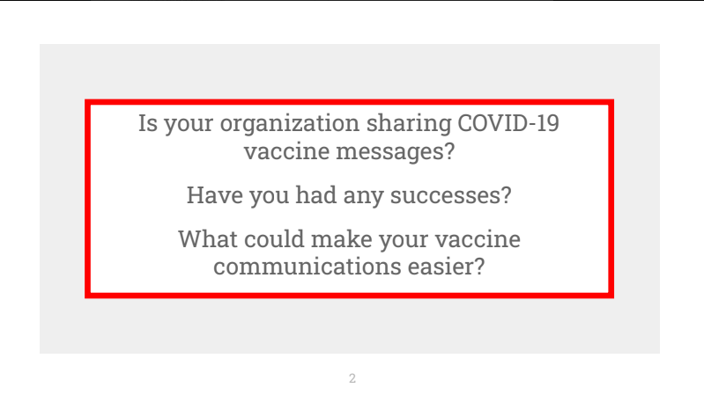

Slide 21
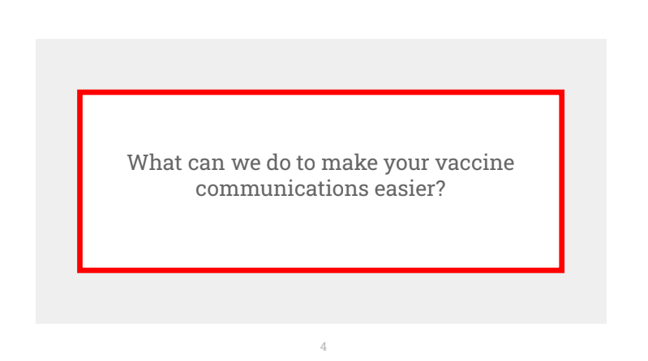

Slide 22
